Slide 1
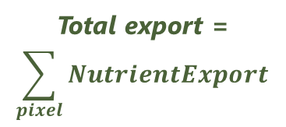

NDR – Transport/Retention
NDR is a function of Upslope transport and Downslope retention
a
Downslope path
(retention)
Upslope area
(transport)
Per pixel:
$$NutrientExport=load ×NDR$$
Pixel of interest (N/P load)
Total export =
$$\sum_{pixel}{NutrientExport}$$
Stream
Nutrient exported to the stream
Notes:
These slides are from training material, not exactly what's in the User Guide, but can be used as a basis for updating the UG graphics.

Slide 2
Sub-surface nitrogen
ps = proportion of N that is subsurface
a
(1-ps) × load_N
load_N
ps × load_N
(1-ps) × load_N × NDR
Stream
ps × load_N × NDR_{subs}
Notes:
These slides are from training material, not exactly what's in the User Guide, but can be used as a basis for updating the UG graphics.

